Slide 1
UNIT-3
Software Testing Life Cycle

Slide 2
Topics to be covered
1 Principle of verification and validation
2. Techniques of verification
Reviews
Inspection
Walkthrough
3. V-testing Model
a. Software development V & V
b. Software Acquisition V & V
c. Software Supply V & V.

Slide 3
STLC
Software Testing Life Cycle process is an integral part of the Software Development Life Cycle. The overall aspect of STLC phase deals with testing and rectifying any error code generating within the program under various test conditions.

Slide 4
What is STLC?
STLC is simply a testing phase in the SDLC development. Validation and Verification is tried and tested in this phase. The only limitation of this cycle is that it is limited to respective individual phase and is carried out by a group of skilled testers.

Slide 5
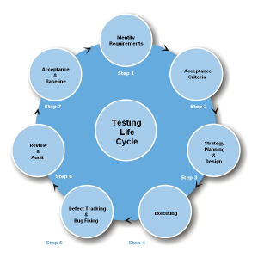

Slide 6
PHASES OF STLC
TEST PLANNING – Preparing the test strategy & planning
TEST DEVELOPMENT – Creating the testing environment
TEST EXECUTION – Writing the test cases/Creating & Executing the Test Script
RESULT ANALYSIS – Analysis result and Bug report
BUG TRACKING – Analyze Bugs and application errors
REPORTING – This is a post conditional process which involves collecting data from end users

Slide 7
Difference Between SDLC and STLC
SDLC (Software Development Life cycle) | STLC (Software Test Life Cycle)
SDLC is Software Development Lifecycle, it is a systematic approach to develop a software. | The process of testing a software in a well planned and systematic way is known as software testing life cycle(STLC).
Requirements gathering | Requirements Analysis is done is this phase, software requirements are reviewed by test team.
Design | Test Planning, Test analysis and Test design is done in this phase. Test team reviews design documents and prepares the test plan.
Coding or development | Test construction and verification is done in this phase, testers write test cases and finalizes test plan.
Testing | Test Execution and bug reporting, manual testing, automation testing is done, defects found are reported. Re-testing and regression testing is also done in this phase.
Deployment | Final testing and implementation is done is this phase and final test report is prepared.
Maintenance | Maintenance testing is done in this phase.
Software development life cycle(SDLC) and Software Testing Life cycle(STLC) go parallelly.

Slide 8
Software Verification
Act of reviewing, inspecting, testing, checking, auditing, or otherwise establishing and documenting whether items, processes, services or documents confirm conventional to specified requirements.
Process of evaluating a system or component to determine whether the products of a given development phase satisfy the conditions imposed at the start of the phase .

Slide 9
Validation
Validation is, according to its ANSI/IEEE definition, 'the process of evaluating a system or component during or at the end of the development process to determine whether it satisfies specified requirements'.
Validation is, therefore, 'end-to-end' verification.

Slide 10
In simple words Verification & validation
Software verification asks the question, "Are we building the product right?” that is, does the software conform to its specification.
Software validation asks the question, "Are we building the right product?"; that is, is the software doing what the user really requires.

Slide 11
Techniques of verification
Reviews
Inspection
Walkthrough

Slide 12
1:-Software reviews
Software reviews is of two type
i. Software Management Review
ii. Software Audit Review

Slide 13
Software management reviews
Conducted by management representatives to evaluate the status of work done and to make decisions regarding downstream activities.

Slide 14
Definition of Software management reviews by the IEEE as:
A systematic evaluation of a software acquisition, supply, development, operation, or maintenance process performed by or on behalf of management ... [and conducted] to monitor progress, determine the status of plans and schedules, confirm requirements and their system allocation, or evaluate the effectiveness of management approaches used to achieve fitness for purpose.
Management reviews support decisions about corrective actions, changes in the allocation of resources, or changes to the scope of the project.

Slide 15
Software Audit Reviews
Software audit reviews are conducted by personnel external to the software project, to evaluate compliance with specifications, standards, contractual agreements, or other criteria.

Slide 16
A software audit review
A software audit review, or software audit, is a type of software review in which one or more auditors who are not members of the software development organization conduct "An independent examination of a software product, software process, or set of software processes to assess compliance with specifications, standards, contractual agreements, or other criteria".

Slide 17
2:-Software Inspection
Inspection in software engineering refers to peer review of any work product by trained individuals who look for defects using a well defined process .
An inspection is one of the most common sorts of review practices found in software projects.
The goal of the inspection is to identify defects

Slide 18
Inspection roles
During an inspection the following roles are used.
Author: The person who created the work product being inspected.
Moderator: He is the leader of the inspection. The moderator plans the inspection and coordinates it.
Reader: The person reading through the documents, one item at a time. The other inspectors then point out defects.
Recorder/Scribe: The person that documents the defects that are found during the inspection.
Inspector: The person that examines the work product to identify possible defects

Slide 19
The Inspection Process
Planning: The inspection is planned by the moderator.
Overview meeting: The author describes the background of the work product.
Preparation: Each inspector examines the work product to identify possible defects.
Inspection meeting: During this meeting the reader reads through the work product, part by part and the inspectors point out the defects for every part.
Rework: The author makes changes to the work product according to the action plans from the inspection meeting.
Follow-up: The changes by the author are checked to make sure everything is correct.

Slide 20
Inspection types
Code review
Peer Reviews

Slide 21
Code Reviews
A code review can be done as a special kind of inspection in which the team examines a sample of code and fixes any defects in it.
In a code review, a defect is a block of code which does not properly implement its requirements, which does not function as the programmer intended, or which is not incorrect but could be improved .
In addition to helping teams find and fix bugs, code reviews are useful for both cross-training programmers on the code being reviewed and for helping junior developers learn new programming techniques.

Slide 22
Peer Reviews
Peer reviews are considered an industry best-practice for detecting software defects early and learning about software artifacts(software source code).
The elements of Peer Reviews include the structured review process, standard of excellence product checklists, defined roles of participants, and the forms and reports.

Slide 23
3:-Software walkthrough
a walkthrough or walk-through is a form of software peer review "in which a designer or programmer leads members of the development team and other interested parties through a software product, and the participants ask questions and make comments about possible errors, violation of development standards, and other problems“
A walkthrough differs from software technical reviews in its o
A walkthrough is normally organized and directed by the author of the technical document.

Slide 24
. V-testing Model
a. Software development V & V
b. Software Acquisition V & V
c. Software Supply V & V.

Slide 25
V-Model
V- model means Verification and Validation model.
Just like the waterfall model, the V-Shaped life cycle is a sequential path of execution of processes.
Each phase must be completed before the next phase begins.
Testing of the product is planned in parallel with a corresponding phase of development.

Slide 26
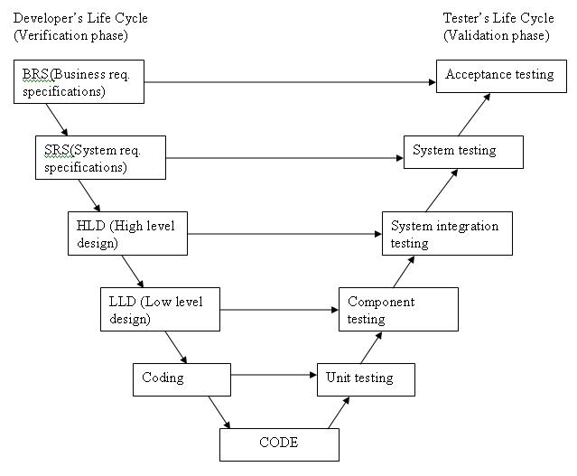

Slide 27
Different Phases of V-Model

Slide 28
1:-Requirements Phase
Requirements like Business Requirement Specification and system Requirement Specification begin the life cycle model just like the waterfall model.
In V- model before development is started, a system test plan is created.
The test plan focuses on meeting the functionality specified in the requirements gathering.

Slide 29
2:-The High-Level Design Phase
This phase focuses on system architecture and design.
It provide overview of solution, platform, system, product and service/process.
An integration test plan is created in this phase as well in order to test the component/modules of the software systems ability to work together.

Slide 30
3:-The Low-Level Design Phase
The low-level design (LLD) phase is where the actual software components are designed.
It defines the actual logic for each and every component of the system.
Class diagram with all the methods and relation between classes comes under LLD.
Component tests are created in this phase as well.

Slide 31
4:-The implementation Phase
The implementation phase is, again, where all coding takes place.
Once coding is complete, the path of execution continues up the right side of the V where the test plans developed earlier are now put to use.

Slide 32
5:-Coding Phase
Coding: This is at the bottom of the V-Shape model. Module design is converted into code by developers.

Slide 33
Advantages of V-model:-
Simple and easy to use.
Testing activities like planning, test designing happens well before coding. This saves a lot of time. Hence higher chance of success over the waterfall model.
Proactive defect tracking – that is defects are found at early stage.
Avoids the downward flow of the defects.
Works well for small projects where requirements are easily understood

Slide 34
Disadvantages of V-model:
Very rigid and least flexible.
Software is developed during the implementation phase, so no early prototypes of the software are produced.
If any changes happen in midway, then the test documents along with requirement documents has to be updated.

